Slide 1
Emerson Early Literacy Challenge
Information Session
September 16, 2024
Welcome! In the chat, please share: - Name - Title - School / District - Favorite thing to do in Fall

Slide 2
Agenda
Jesse
 | Time | Topic | Facilitator
 | 3:30 | Emerson Early Literacy Challenge Framing Gain deeper understanding of the Literacy Challenge Review the program’s Guiding Principles | Jesse Dixon
 | 3:40 | Deep Dive into the Learning Experience Meet Instruction Partners, the literacy experts supporting the Literacy Challenge Learn more about the two-year learning journey, including diagnostics, cohort sessions, site visits and coaching Discuss the expected program outcomes | Instruction Partners Team
 | 3:50 | Application Review Learn more about the application’s components and how to submit the application online Discuss application criteria and scoring process Review key application dates | Jesse Dixon
 | 4:00 | Q&A Opportunity to ask questions on the learning experience or application process | Jesse Dixon & Instruction Partners Team
Note: This session is being recorded

Slide 3
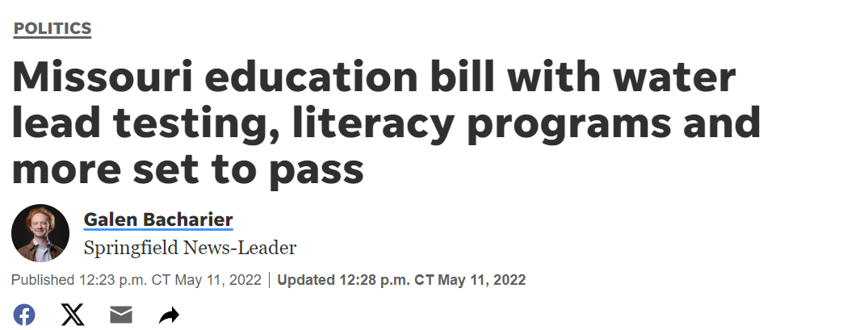
Our Core Values
Building off the momentum of Right to Read, we aim to inspire accelerated progress through shared learning and proof points
Jesse
Right to Read is pursuing equity through literacy across the nation
In 2022, Missouri passed Senate Bill 681, mandating evidence-based reading instruction
In 2023, the Missouri Read, Lead, Exceed initiative allocated $60 million in funding to support student literacy
Earlier this year, several St. Louis NAACP chapters launched a reading campaign
Building on this momentum, we aim to inspire accelerated reading progress by 3rd grade through shared learning and local proof points

Slide 4
Guiding Principles
Jesse
1.
2.
3.
4.
Literacy is a human & civil right
All children are capable of reading proficiently by 3rd grade and doing so is foundational to success in school and in life.
Proficiency is possible with the right conditions and approaches
Schools and school systems applying the science of reading and learning science consistently are creating classrooms where the majority of students irrespective of background attain grade level proficiency.
Collaboration is essential to accelerate improvement
The best solutions for St. Louis schools will be developed by education leaders who collectively share their expertise, learn from promising practices locally and nationally, and engage parents and community as partners.
­Proof points will catalyze a greater collective sense of possibility
Having local examples of what is possible are essential to sustaining the changes required at the school, system, and state level to ensure all children in our public schools can read proficiently by 3rd grade.

Slide 5
Emerson Early Literacy Challenge Program Timeline
Our Core Values
Laken
2024
2025
Activity
Sep
Oct
Nov
Dec
Jan
Feb
Mar
Apr
May
Application process
Due 9/26
Winners announced & $20,000 grants awarded
10/10
Cohort session #1 (1 day in person)
10/24
Cohort session #2 (1 day in person)
TBC
2-day visit to effective learning site
TBC
Cohort session #3 (1 day in person)
TBC
Instructional diagnosis (Literacy experts visit LEA)
1:1 Coaching
LEAs develop literacy plans for ’25-’26 SY
Submit plans in Feb
LEAs receive feedback on literacy plans

Slide 6
Introduction to Instruction Partners
Jesse to intro Laken, and Instruction Partners to share screen / materials due to formatting challenges

Slide 7
Introduction to Instruction Partners
Notes:
Speaker notes:
For those of you who are unaware of Instruction Partners, we are a group of educational nerds who work alongside educators and leaders support equitable access to great instruction.
We share a deep commitment to ensuring that every student, regardless of their background, has access to the quality education they deserve.

Slide 8
Vision and mission
Our Vision All students experience an excellent education that prepares them to contribute to their community, achieve economic security, and pursue their dreams.
Our Mission
We strengthen instructional leadership in schools, school systems, and states to ensure teachers have the support they need to improve learning experiences and learning outcomes for students—with attention to students of color, students experiencing poverty, multilingual learners, and students with disabilities.

Slide 9
Our values
Our values
Our learning agenda
Notes:
These aren’t just words on paper–we live these values every day in our work.

Slide 10
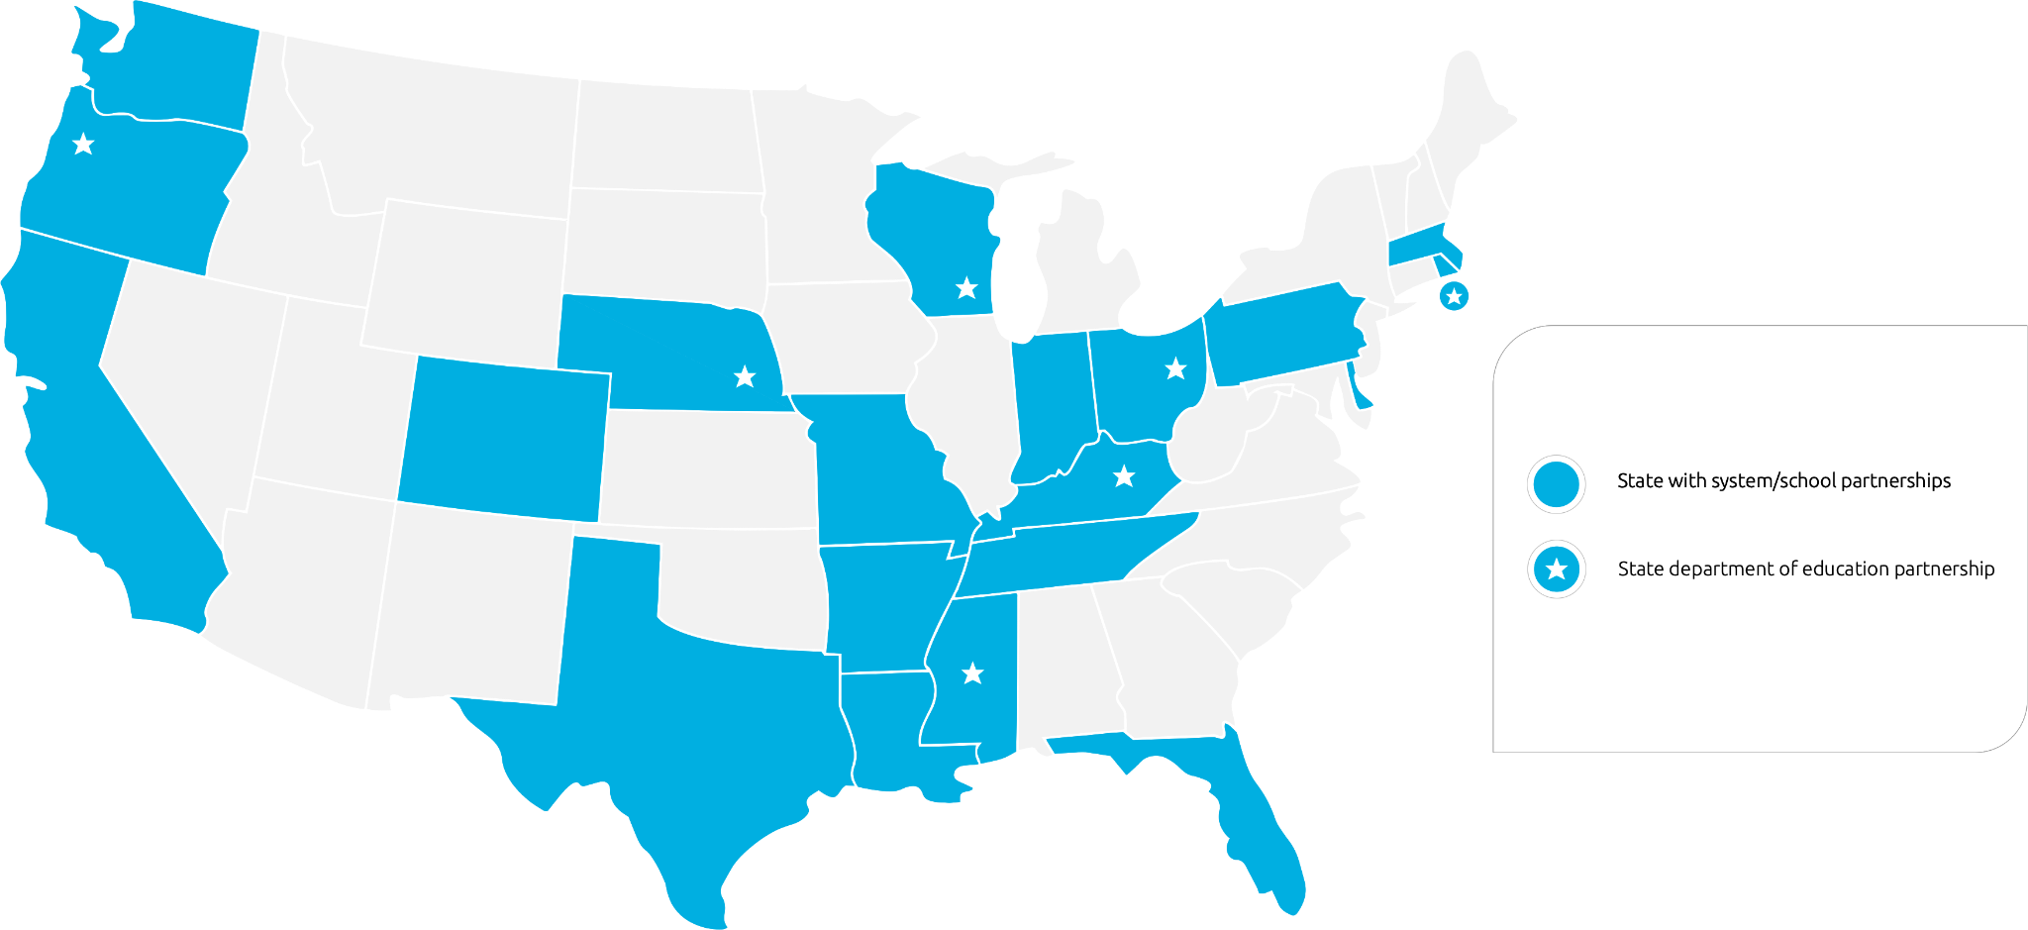
Where we work

Slide 11
Instruction Partners Team
Ashley Cook
Laken Detchemendy

Slide 12
Our charge
We help school and system leaders strengthen content-specific professional learning structures so that teachers can deliver exceptional Tier 1 instruction that addresses every student’s learning needs.
Notes:
We help school and system leaders diagnose and strengthen equitable, standards-aligned instruction that addresses every student’s needs. Our work focuses on helping leaders develop sustainable, content-specific professional learning systems so that teachers can deliver exceptional Tier 1 instruction.

Slide 13
Essential practices for early literacy instruction
The essential practices are:
Rooted in a systematic and explicit foundational skills program as well as content-rich knowledge building
Field-tested in schools and systems across the country
Responsive to learning challenges resulting from unprecedented disruptions in schooling
We set out to identify the most critical elements of high-quality, effective early literacy systems.
We discovered that the solution lies at the school and district level.
We assembled a set of practices that invite leaders and teachers to reimagine how they center early literacy instruction to accelerate students’ development of foundational reading skills.
Notes:
In early 2020, we set out to identify the most critical elements of high-quality, effective early literacy systems. We combed through research, field-tested hypotheses, and codified recommendations based on what we learned from working with school system partners.
What we discovered is that even though common barriers like ineffective materials, misaligned interventions, and inadequate teacher support play out in classrooms, the solution actually lies at the school and district level.
Based on our research and fieldwork, we assembled a set of practices that invite leaders and teachers to reimagine how they center early literacy instruction to accelerate students’ development of foundational reading skills.

Slide 14
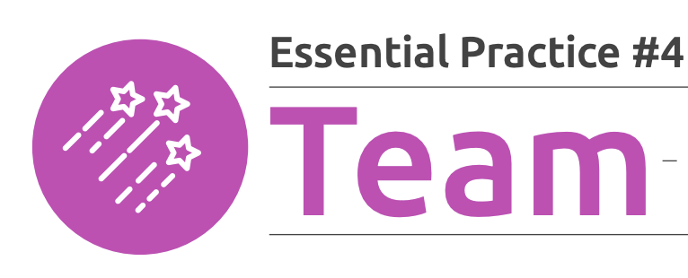
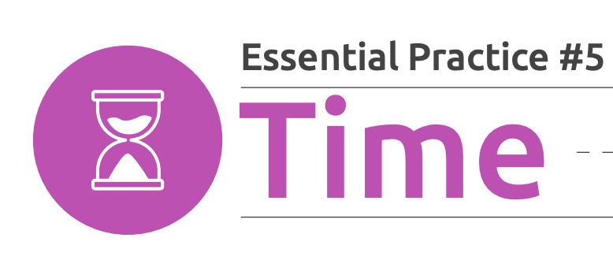
Early Literacy Essential Practices
The
ELA
Shifts
Reading, writing, speaking and listening grounded in evidence from texts
*Regular systematic and explicit approach to foundational skills*
Notes:
We identified five practices that are essential to an effective early literacy system: 1) an early literacy vision grounded in the science of reading along with the right folks with the right responsibilities in place to fulfill that vision.; 2) high-quality materials that attend to foundational skills, knowledge building, and vocabulary instruction; 3) routine data practices that enable educators to keep a real-time pulse on student progress and make informed instructional decisions; 4) a well-informed and skilled team that has the resources it needs to support educators and students; and 5) sufficient time for educators to teach and engage in ongoing professional learning and early literacy responsibilities.
The five essential practices in early literacy capture the systemic factors at the school and system levels that influence early literacy instruction in classrooms and illustrate what needs to be in place for students to reliably read proficiently by the time they leave the 2nd grade.* These practices are rooted in research on the science of reading, but extend beyond the core tenets of this research in recognition of the fact that 1) the science of reading, in and of itself, isn’t fully responsive to the unique needs of MLs¹⁰ and that 2) there are many structures and routines in schools and systems that influence how, when, and with what quality those tenets are implemented. Each essential practice is broken into indicators that illustrate what effective implementation of the practice looks like in systems, schools, and classrooms. Since the initial release of the essential practices in November 2021, we have refined and reordered their corresponding indicators to best reflect what we learned over the course of another year of working in schools and to better respond to the unique needs of multilingual learners.

Slide 15
Early Literacy Playbook
Notes:
Over the years, there has been an overarching trend in our discussions with partners, colleagues, and other early literacy professionals.. that trend being HOW overwhelming creating an extensive plan for early literacy instruction and aligning support can be.
And…. A key deliverable for the 2022-2023 school year was to develop an EXTERNAL resource to release and share broadly across the country to solve for this.
With all of this in mind we set out to solve for those challenges. When we first began our discussions around how do design the playbook one word kept coming to the surface- and that word was “practical.” We wanted to provide a practical, easy-to-use tool that leaders could use to identify and understand how to develop an early literacy system whether starting from scratch or working to refine a system that is already in place.
We wrote, learned, and reworked, and wrote, learned, and reworked iteration after iteration always looking through the lens of practicality which brought us to the tool now published on our website . The Early Literacy Playbook provides any district or school leader free ready-to-use, step-by-step guidance—including templates and examples—that early literacy leaders and educators can use to strengthen and monitor early literacy in their school or district.

Slide 16
Lessons learned
This process is complex and can’t all be accomplished at once
Sustainability of the early literacy system is dependent on the continuous implementation of a select group of indicators.
Supports for multilingual learners should be embedded
Implementation is only as strong as the team who leads it
Notes:
<click>
We have learned that there are a set of key indicators that must be revisited in order to sustain the system. (some examples are coming back to vision and roles and responsibilities, team structures, and regular step backs.
<click>
Another lesson we learned pretty quickly is that we needed more than an “for all students” general approach. When we were looking at partner schools’ data, it became clear that the multilingual learner population specifically needed additional attention. We want to reinforce how supporting priority student groups is not something separate, that, in fact, should be the start of any program and instructional design and certainly integrated throughout all professional learning opportunities. We hope to reinforce that supporting MLs is part of providing quality Tier 1 curriculum and instruction.
<click>
A conclusion that you have probably already come to on your own is that the work of transforming early literacy instruction is ALOT and can’t be accomplished all at once. We hope to support LEAs in taking one step at a time in a way that feels manageable and helps partners stay the course. The good news is that every step they take in this journey will in the end greatly impact the students AND LEAs will definitely see the changes positively impacting students along the way!
<click>
The success of the work is dependent on the team that is put in place to do this work within the LEAs. A team with clear roles, responsibilities, and support is imperative. Take the time to support the partner to get the team in place, ensure they have the tools and resources they need, and support them in taking time to step back and adjust team as needed. Continuously supporting district and school leadership in strengthening their internal teams will have an immeasurable effect on the success of their early literacy system.

Slide 17
What are the expected outcomes?

Slide 18
Outcomes of the learning experience
LEAs have clarity on the current state of their early literacy systems, aligned to the essential practices
School and system leader capacity is built around critical components of high quality systems to support strong early literacy instruction, including vision, materials, data, time, and talent
School and system leader capacity is deepened around their understanding and ability to support quality implementation of their previously selected HQIM
LEAs develop a 3-year strategic plan for early literacy attached to goals around increasing student ELA proficiency in grade 3 and action plan for SY25-26

Slide 19
Cohort Experiences
Essential Practice and Instructional Diagnostic
LEA 1:1 Coaching
Successful Site Visit
Initial TA Support

Slide 20
Cohort Sessions
Cohort Session #1, October 24th
Build community, deepen sense of the challenge, complete self-score of essential practice diagnostic and reflect on current early literacy vision, develop aspirations for our work together
Cohort Session #2, November/December
Deepen collective knowledge about the science of reading and culturally sustaining literacy practices, fundamentals of the essential practices and key criteria of strong early literacy systems, and key moves in curriculum implementation. LEAs will share out current strengths across their systems.
Cohort Session #3, January 2025
LEAs sharing and tuning across the cohort for facilitated prioritization of outcomes, goal setting, and the beginning of strategic plan development. LEAs will have opportunities to both collaborate cross cohort, have role-alike time, and dedicated LEA planning time throughout the day.

Slide 21
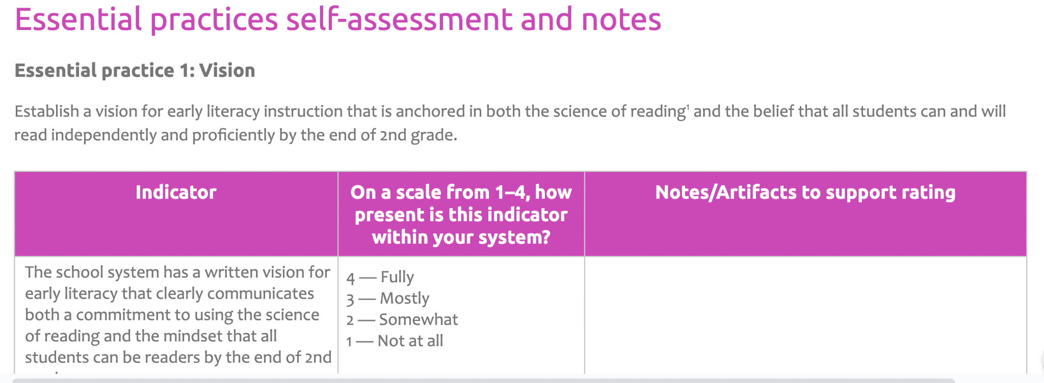
LEA Essential Practice and Instructional Diagnosis
Instruction Partners facilitates an essential practice diagnostic, inclusive of observations of early literacy instruction across participating LEAs, review current student outcomes data, and review of current professional learning system artifacts. LEAs receive report on analysis.
Notes:
In November.
We have found in our work with partners across the country that an outside perspective on the current state of systems and instruction is crucial to a LEAs understanding of the work ahead. To support systems in both better understanding the current realities and to build their capacity to be able to define high quality instructional practice in early literacy, we anticipate conducting a diagnosis of current practices across each LEA. The on-site part of the diagnoses will consist of classroom observations in early literacy, leveraging both the ELA IPG and the Foundational Skills IPG and focus groups of students and teachers. We will also conduct a 2 hour virtual interview with each LEA to assess the state of the Essential Practices, review current student outcomes data, and review artifacts from professional learning systems. These data points will allow our team to produce a current state report, inclusive of their self-diagnoses, for each LEA to guide their strategic planning.
We use the Essential Practices Diagnostic to assess these systems.
Drop Rating Tool in Chat
Essential Practice Diagnostic Rating Tool

Slide 22
LEA 1:1 Coaching
Coaching Call #1
Designed to support the LEA in review of their diagnosis and reflect on their learnings in the cohort up to this point. During this call, Instruction Partners will facilitate a root cause analysis and support the LEA in initial goal setting and prioritization of foci for their strategic plan.
Coaching Call #2
To support LEAs, Instruction Partners will meet with each team twice following the third cohort learning session. During these virtual calls, Instruction Partners will act as thought partners, plan reviewers, and feedback providers to support each LEA in their final plan development.

Slide 23
Learning Site Visit
Building on the work the Cohort has completed up until this point, Instruction Partners will facilitate a site visit for LEAs to observe a system with similar demographics where student outcomes are increasing.
The site visit will include classroom observations, panels with stakeholders, observations of professional learning structures, and facilitated and dedicated time for LEAs to reflect, in addition to role-alike time cross cohort for reflection and planning.

Slide 24
Application Review
Jesse- Ellen will stop sharing slideshow and show online application

Slide 25
Applications will be assessed on four dimensions
Our Core Values
Jesse
Representative LEA Team:
5-10 team member, diverse, motivated teams
A Core Team with a participating principal, head of literacy, and at least two educators
A “Broader Team” consisting of various central office and community perspectives; could include a superintendent, CAO, parents, school board, or other stakeholders
Change-agents who demonstrate the ability to execute and deliver impact
Knowledge & Implementation of Best Practices:
Literacy journey underway; already utilizing green-rated curriculum, phonics, etc.
Baseline knowledge and understanding of the Science of Reading
Motivation to take literacy journey to the next level
Evidence of successfully implementing innovative practices
Culture of continuous learning
Readiness for Change:
Prepared to embrace change and make significant shifts
Display a growth mindset, including a willingness to innovate, openness to feedback, and willingness to make mid-course corrections
Data Driven Culture:
Track record of monitoring results to track student achievement
History of practicing data-driven decision-making
Able to provide clear examples of using data to drive continuous improvement

Slide 26
Key application dates
Jesse
Application Closes | September 26th 11:59pm CT
Capacity Interviews | September 30th - October 8th
Decisions Announced | October 10th
Kickoff Cohort Session | October 24th

Slide 27
Questions?
Jesse

